Slide 1
Lift Assist
Systems Engineering
Nick Skinner
Design Engineering
Courtney Halvorson
Rita Bergstrom
Aidan Trueworthy
Tre Williams

Slide 2

Introductions
Project Timeline

Slide 3
Project Risk Matrix
Introductions
Concept Definition
Elicit Stakeholder Needs
Requirements Definition
Develop Architectures
Design Evolution
Summary

Slide 4
Technology Risk Matrix
Introductions
Concept Definition
Elicit Stakeholder Needs
Requirements Definition
Develop Architectures
Design Evolution
Summary

Slide 5
Systems Engineering Deliverables
Identify/Research System of Interest
Timeline (where are you at?)
Project Charter
Project Objective
System of Interest and Mission Statement
Opportunity Illustration
Scope of Opportunity
Problem Framing Canvas
List of Stakeholders and Needs
System Layers
Context Diagram
System Boundary Diagram
Capture Operational Behavior
High-Level ConOps
Lower-Level ConOps
Use Cases
Sequence Diagrams
Elicit Stakeholder Needs
Discussion of Stakeholder Requirements Pedigree
Discussion of how you elicit/validate needs
Functional Architecture (from Mission Statement down 2 levels)
Functional DSM (top level functions, lower level as needed)
Key System Requirements (functional, performance, design constraints, and quality attributes)
Measure of Success, Measure of Effectiveness, Measure of Performance (MoS, MoE, MoP)
Develop/Evaluate Architectures
Technology Roadmap
Technology Assessment
Morphological Matrix (as needed)
Tradespace Analysis
Structural Architecture (from System of Interest down 2 levels)
Structural DSM (top level elements, lower as needed)
MDM (Functional Architecture vs. Structural Architecture)
MDM (All Requirements vs. Structural Architecture)
Interface Definitions (white box vs. black box)
Introductions
Concept Definition
Elicit Stakeholder Needs
Requirements Definition
Develop Architectures
Design Evolution
Summary

Slide 6
Project Timeline - Systems Engineering
September 2024
Project Proposal
October 2024
November 2024
December 2024
Begin Systems Development
UND - Project Presentation
UND - Prototype Demonstration
Charter & Objective
Mission Statement
Problem Framing Canvas
Stakeholder Interviews
Stakeholder Needs
Functional Architecture
Tradespace Analysis
Technology Assessment
Technology Readiness / Integration Readiness
Risk Assessment
Structural Architecture
Form to Function Mapping
Interface Definition Completion
System Requirements Completion
Requirements Validation
Opportunity Illustrations/Market Analysis
Context Diagram
System Boundary Diagram
Stakeholder List
ConOps
OpsCon
Use Cases
Functional DSM
Stakeholder Requirements
Morphological Matrix
Items marked with * have initial revisions
Items marked with ^ are complete barring new information
Introductions
Concept Definition
Elicit Stakeholder Needs
Requirements Definition
Develop Architectures
Design Evolution
Summary

Slide 7
Project Timeline - Systems Engineering
September 2024
Project Proposal
October 2024
November 2024
Begin Systems Development
UND - Project Presentation
UND - Prototype Demonstration, Simulation, or Test
Charter & Objective
Mission Statement
Problem Framing Canvas
Stakeholder Interviews
Stakeholder Needs
Functional Architecture
Tradespace Analysis
Opportunity Illustrations/Market Analysis
Context Diagram
System Boundary Diagram
Stakeholder List
ConOps
OpsCon
Use Cases
Functional DSM
Stakeholder Requirements
Morphological Matrix
Requirements Validation Strategy
December 2024
Abstract Submission
Continued Systems Development
Introductions
Concept Definition
Elicit Stakeholder Needs
Requirements Definition
Develop Architectures
Design Evolution
Summary

Slide 8
Concept Definition
Charter and Objective
Project Illustration
Problem Canvas
Mission Statement
Context Diagram
System Boundary Diagram

Slide 9
Project Charter – Rev 1
Lift Assist – Mobility For The Future
Champion: University of North Dakota (coursework) Team Lead: (systems) Nick Skinner SME Mentor: Tan Kordell (systems); (Team) TBD | Team Members | Key Stakeholders
 | Nick Skinner, Aidan Trueworthy, Courtney Halvorson, Rita Bergstrom | Operators, Medical Facilities, Physical Therapy Users, Disability Users, University of North Dakota (coursework)
What is the Problem We Want to Solve?
Many people struggle to lift objects, maintain their balance, and manipulate the world around them. Whether that be because of an injury they are getting therapy for, a disability that prevents precise movement or balance, an injury that makes it painful to lift moderate loads, or simply due to old age. While there are technologies being developed to assistance in walking and physical therapy, these devices require a user that either can maintain balance on their own or use an external walker or cane. This prevents a user with disabilities from both having the assistance of an external device in lifting capacity and using that same device to help maintain their balance. Some heavy robotics projects have incorporated both the movement of two legs with the stability of being able to lift a moderate load and balance. Bridging the gap between robotics technologies and incorporating it onto the human body could significantly improve the life of users who wish to regain mobility in their life without having to give something else up.
Business Case
A few companies exist in the exoskeleton space today. Primarily focusing on the medical device industry for physical therapy, or devices for able-bodied people in hiking. However very few devices are both cheap for the user and very useful for long-term assistance in people with lifelong disabilities or joint pain. By bridging these industries, an at-scale assistance device could be created to allow many people to afford comfortabilities they may have once had.
In Scope | Key Milestones
All disabilities, injuries, and aging that limits a user's mobility Mechanical Exoskeletons to transfer power Joint technologies Controls and Electronics for active stabilization Mechanical devices for passive assistance A workable prototype to research active assistance | Development of a prototype that can attach to the knee joint of an operator and support knee weight Development of a prototype that can attach to the knee prototype and foot to support the weight from ground to thigh Investigation into efficient methods of active stabilization A technology investigation into methods of supporting an operator and active stabilization All systems engineering artifacts pertaining to users and improving mobility Completion of University of North Dakota project courses
Deliverables
Systems engineering into stabilization and mobility assistance of human limbs | A prototype test unit to assist users in leg movement | Addition of sensors and movement feedback for active assistance Addition of passive or active stabilization of a person while standing still | Active stabilization of the user during walking | Active stabilization of the user during running
Introductions
Concept Definition
Elicit Stakeholder Needs
Requirements Definition
Develop Architectures
Design Evolution
Summary

Slide 10
Project Charter – Rev 2
Lift Assist – Mobility For The Future
Champion: University of North Dakota (coursework) Team Lead: (Systems) Nick Skinner SME Mentor: (Systems) Tan Kordell; (Team) Julian Thrash | Team Members | Key Stakeholders
 | Nick Skinner, Aidan Trueworthy, Courtney Halvorson, Rita Bergstrom, Tre Williams | Operators, Medical Facilities, Physical Therapy Users, Disability Users, University of North Dakota (coursework)
What is the Problem We Want to Solve?
Many people struggle to lift objects, maintain their balance, and manipulate the world around them. Whether that be because of an injury they are getting therapy for, a disability that prevents precise movement or balance, an injury that makes it painful to lift moderate loads, or simply due to old age. While there are technologies being developed to assistance in walking and physical therapy, these devices require a user that either can maintain balance on their own or use an external walker or cane. This prevents a user with disabilities from both having the assistance of an external device in lifting capacity and using that same device to help maintain their balance. Some heavy robotics projects have incorporated both the movement of two legs with the stability of being able to lift a moderate load and balance. Bridging the gap between robotics technologies and incorporating it onto the human body could significantly improve the life of users who wish to regain mobility in their life without having to give something else up.
Business Case
A few companies exist in the exoskeleton space today. Primarily focusing on the medical device industry for physical therapy, or devices for able-bodied people in hiking. However very few devices are both cheap for the user and very useful for long-term assistance in people with lifelong disabilities or joint pain. By bridging these industries, an at-scale assistance device could be created to allow many people to afford comfortabilities they may have once had. Many companies also focus primarily on a resistive technique to help strengthen muscles rather than assisting in getting up from a sitting or lying position. Alongside difficulties with the operator getting into the walking position, nurses or assistants can struggle using existing technologies without undue strain on themselves or the end user. With a better active support system, users may be able to get into the walking position with limited or not assistance.
In Scope | Key Milestones
Users with difficulty standing up from a sitting or lying position Uses with Kyphosis or other similar conditions Passive or active stabilization methods Attached (exoskeleton) or detached system to the human body | Development of a prototype that can attach to the knee joint of an operator and support knee weight Development of a prototype that can attach to the knee prototype and hip to help support both joint weights Investigation into efficient methods of active stabilization A technology investigation into methods of supporting an operator and active stabilization All systems engineering artifacts pertaining to users and improving mobility Completion of University of North Dakota project courses
Deliverables
A knee and hip prototype system that is attachable to a human body | Addition of sensors and movement feedback for active assistance Addition of passive or active stabilization of a person while standing still | Active stabilization of the user during walking
Introductions
Concept Definition
Elicit Stakeholder Needs
Requirements Definition
Develop Architectures
Design Evolution
Summary

Slide 11
Project Objective – Rev 1
To develop a system that allows users with impaired movement ability to regain their ability to move around. (Value Needed)
By understanding the functions of a mobile human body and likely impairments to develop a system to relieve those impairments. (Action Needed)
Using industry and academic knowledge to apply the system engineering methodology. (Process or System Delivering the Value)
While satisfying industry standards and regulations that may be required for a future state and coursework for the University of North Dakota. (Constraint)
Introductions
Concept Definition
Elicit Stakeholder Needs
Requirements Definition
Develop Architectures
Design Evolution
Summary

Slide 12
Project Objective – Rev 2
To develop a system that assists users with impaired movement conditions, such as Kyphosis, with being able to stand up and walk around. (Value Needed)
By understanding the functions of a mobile human body and impairments from Kyphosis or similar conditions to develop a system to relieve those conditions. (Action Needed)
Using industry and academic knowledge to apply the system engineering methodology. (Process or System Delivering the Value)
While satisfying industry standards and regulations that may be required for a future state and coursework for the University of North Dakota. (Constraint)
Introductions
Concept Definition
Elicit Stakeholder Needs
Requirements Definition
Develop Architectures
Design Evolution
Summary

Slide 13
Not too much force, due to bone density
Constraint on how expensive it might be allowed to be
Less space required
Limited to self-assist from the person with Kyphosis
Check under "balance issue"

Slide 14
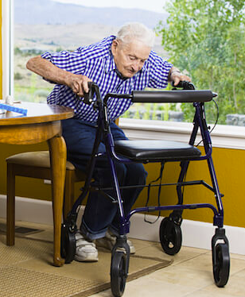
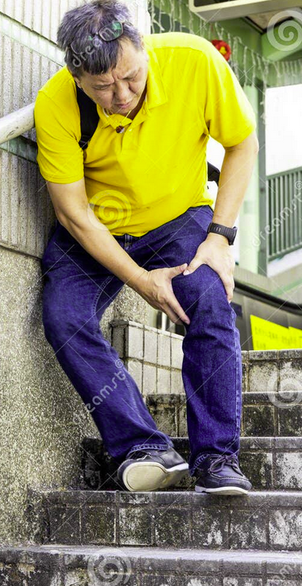
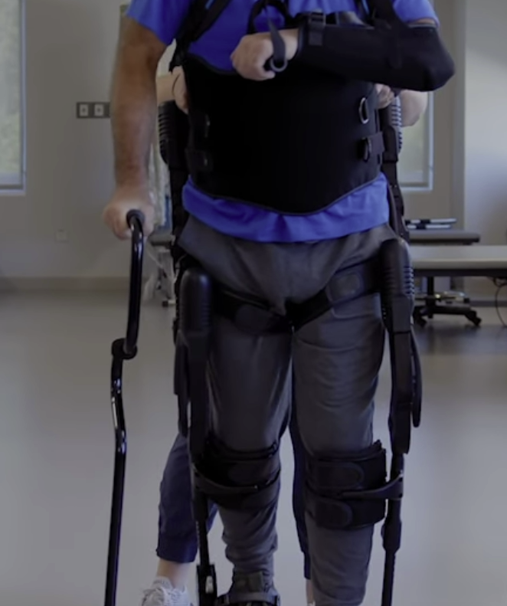
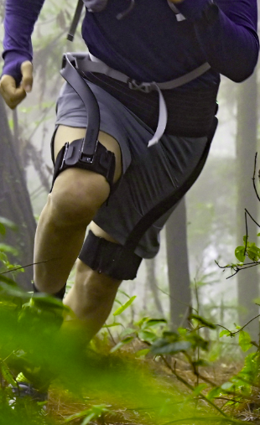
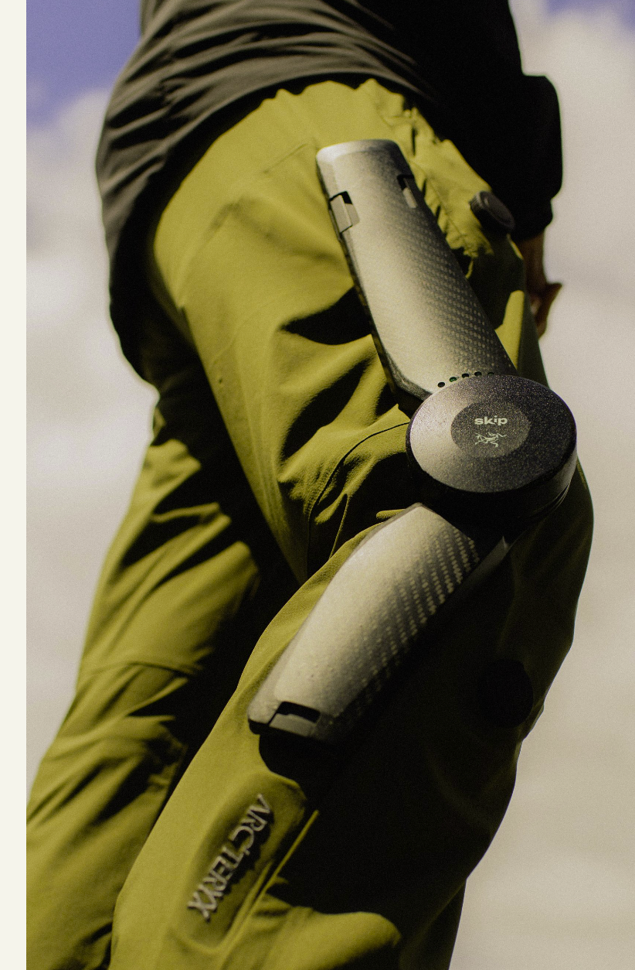
Opportunity Illustration (Legs) – Rev 1
Users can struggle to stand up from a sitting or lying position
Use of a walker or cane hinders daily life
Devices make standing or moving around difficult for long periods of time
Some users simply struggle with knee pain
Pain when walking can cause trips and falls
Requires cane/walker
No active stabilization
Supports hip, knee, and foot
Primary physical therapy use
Hiking/Running, General Use
Assumes able-bodied
Complex AI engine
Unknown potential (unreleased)
>1M in Kickstarter funding
Does not support knee joint, putting extra pressure on it
For Hiking (2025)
Expensive ($5,000)
Specialty Motor and Design
Long Setup Time (internal braces)
No Active Stabilization
Introductions
Concept Definition
Elicit Stakeholder Needs
Requirements Definition
Develop Architectures
Design Evolution
Summary

Slide 15
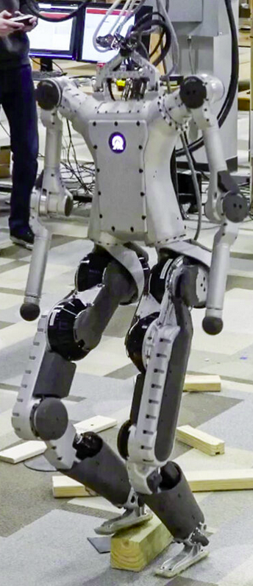
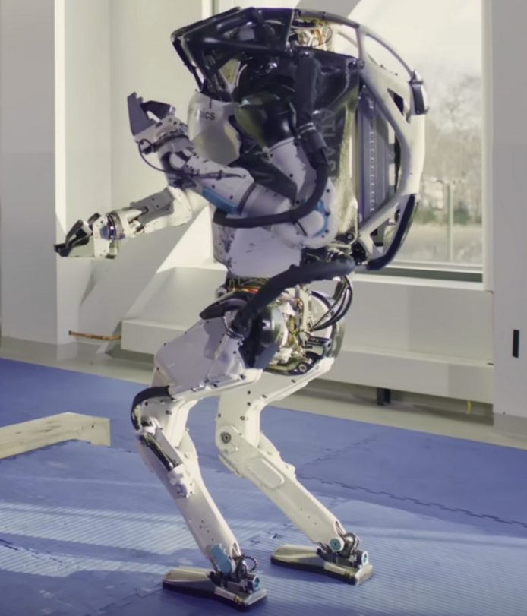
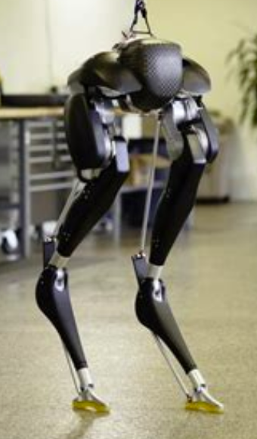
Opportunity Illustration (Active Stabilization) – Rev 1
Decades of research done in balancing robotics, include heavier-than-human loads.
Robotics typically controls all joint force/balance. An external system must account for unpredictable or semi-predictable movement.
Some robotics use non-human shapes for efficiency.
https://www.sfu.ca/sfunews/stories/2023/11/xomotion-created-by-sfu-researchers-to-be-world-s-most-advanced-.html
Introductions
Concept Definition
Elicit Stakeholder Needs
Requirements Definition
Develop Architectures
Design Evolution
Summary

Slide 16
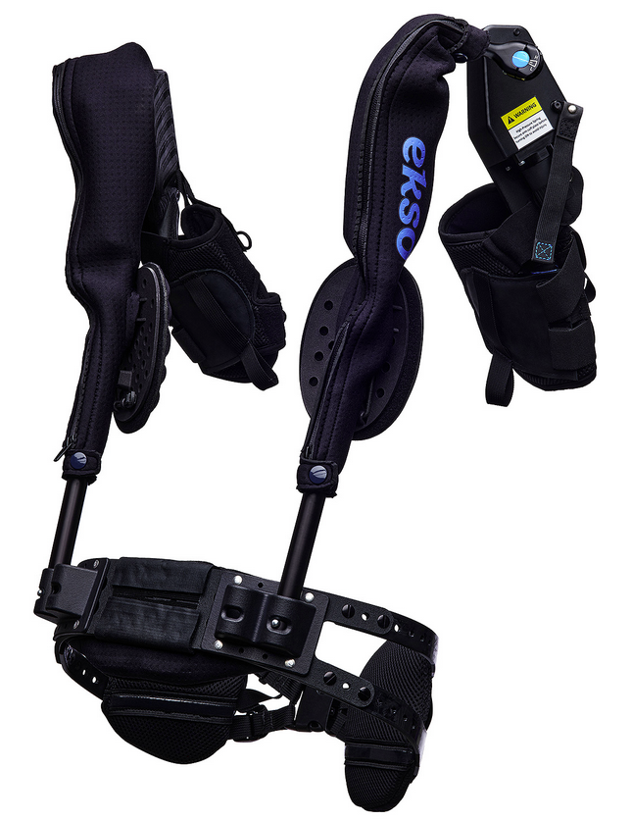
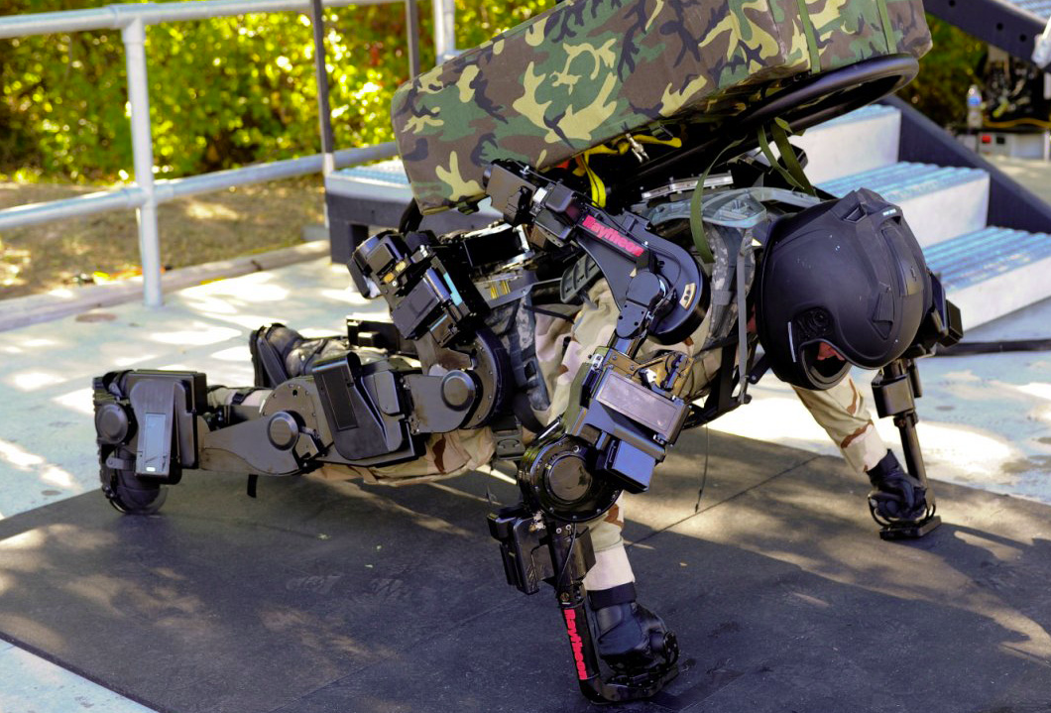
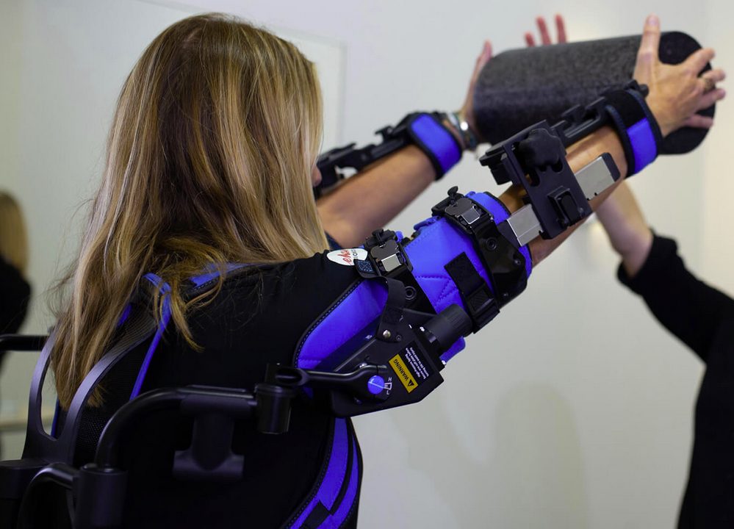
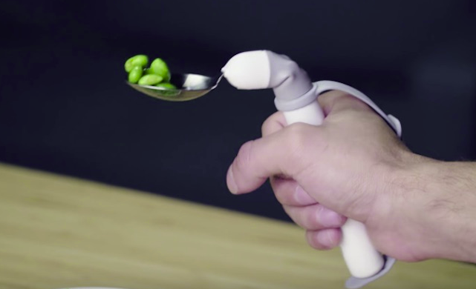
Opportunity Illustration (Arms) – Rev 1
Most assistance for arms focus on strength or fatigue
Almost no consideration for people with stability issues
Some smaller product focus on helping people with stability issues eat or do common dexterous tasks
Introductions
Concept Definition
Elicit Stakeholder Needs
Requirements Definition
Develop Architectures
Design Evolution
Summary

Slide 17
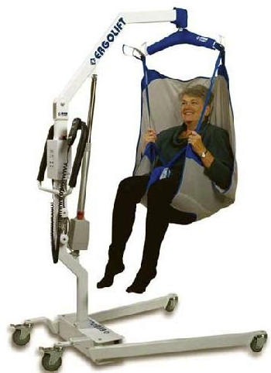
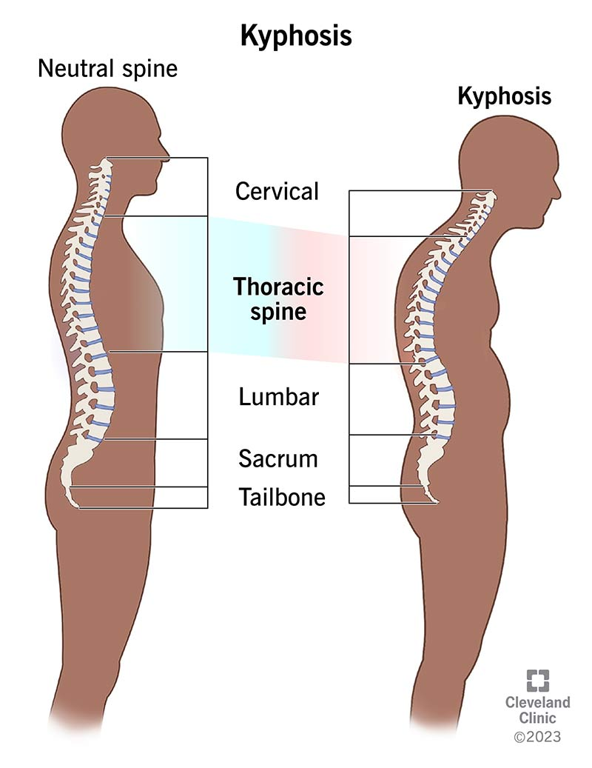
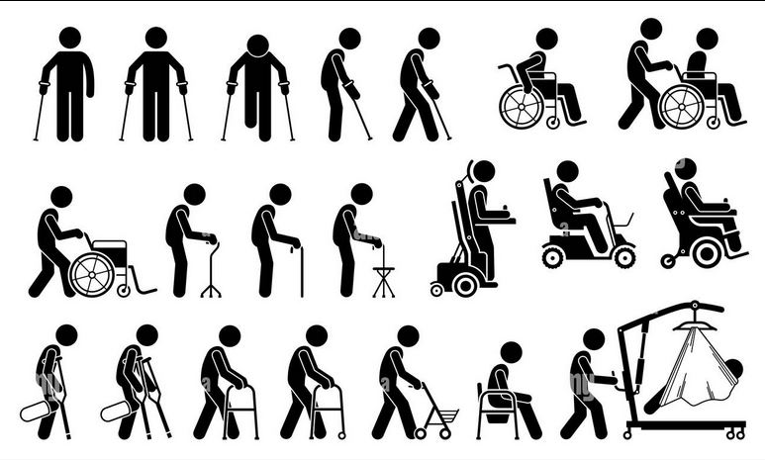
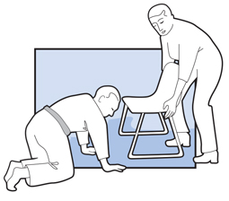
Opportunity Illustration – Rev 2
Many devices are used today to prevent someone with difficulties standing on their own from falling over
Most devices function. while the user is already standing or walking and require other movement to get into position.
Lifts can be expensive, bulky, and difficult to get users into.
Many nurses may not have strength to get users into the unit without a lot of strain.
The sling may be uncomfortable for some users.
Users with Kyphosis (or similar conditions) can have difficulties keeping balanced due to a hunched-over upper body.
Falling while trying to stand leads to new injuries or exacerbation of existing disabilities or injury
Introductions
Concept Definition
Elicit Stakeholder Needs
Requirements Definition
Develop Architectures
Design Evolution
Summary

Slide 18
Opportunity Illustration (Markets) – Rev 1
“Excessive Kyphosis has detrimental effects on erect posture that can lead to impaired balance and an increased risk of falling”[1]
“Postural changes in sagittal plane alignment can lead to limitations in performing daily activities, […] physical function, falls and fractures that can negatively impact health-related quality of life”[1]
“After excluding congenital and neuromuscular scoliosis, the number of patients diagnosed with scoliosis between 2011 and 2015 was 267,283.” [2]
From 1999 through 2008, the USA had a rate of 2.29 knee injuries per 1,000 population[5], with those in 15 to 24 years of age having the highest injury rate at 3.83 per 1,000 population.[5]
In a study of seating in aged care, 10% used a wheelchair, 25% a walking stick, 50% a walker, and 15% with no external support[6]
In all STS (Sit-to-Stand) transitions, 90% involved careful, considered techniques, with 100% involving leaning forward and pushing up on something.[6]
Roghani, T., Zavieh, M. K., Manshadi, F. D., King, N., & Katzman, W. (2016). Age-related hyperkyphosis: update of its potential causes and clinical impacts—narrative review. Aging Clinical and Experimental Research, 29(4), 567–577. https://doi.org/10.1007/s40520-016-0617-3
Scoliosis – Sung, S., Chae, H.-W., Lee, H. S., Kim, S., Kwon, J.-W., Lee, S.-B., Moon, S.-H., Lee, H.-M., & Lee, B. H. (2021, August 1). Incidence and surgery rate of idiopathic scoliosis: A nationwide database study. International journal of environmental research and public health. https://www.ncbi.nlm.nih.gov/pmc/articles/PMC8346015/ McIntyre, S., Goldsmith, S., Webb, A., Ehlinger, V., Hollung, S. J., McConnell, K., Arnaud, C., Smithers‐Sheedy, H., Oskoui, M., Khandaker, G., & Himmelmann, K. (2022). Global prevalence of cerebral palsy: A systematic analysis. Developmental Medicine & Child Neurology, 64(12), 1494–1506. https://doi.org/10.1111/dmcn.15346
Elgaddal, N., Kramarow, E., Weeks, J., & Reuben, C. (2024). Arthritis in adults age 18 and older: United States, 2022. https://doi.org/10.15620/cdc:145594
Gage, B. E., McIlvain, N. M., Collins, C. L., Fields, S. K., & Comstock, R. D. (2012). Epidemiology of 6.6 million knee injuries presenting to United States emergency departments from 1999 through 2008. Academic Emergency Medicine, 19(4), 378–385. https://doi.org/10.1111/j.1553-2712.2012.01315.x
Knee Osteoarthritis – Cui, A., Li, H., Wang, D., Zhong, J., Chen, Y., & Lu, H. (2020, November 26). Global, regional prevalence, incidence and risk factors of knee osteoarthritis in population-based studies. EClinicalMedicine. https://www.ncbi.nlm.nih.gov/pmc/articles/PMC7704420/
Blackler, A., Brophy, C., O’Reilly, M., & Chamorro-Koc, M. (2018, January 4). Seating in aged care: Physical fit, independence and comfort. SAGE open medicine. https://www.ncbi.nlm.nih.gov/pmc/articles/PMC5758957/
Introductions
Concept Definition
Elicit Stakeholder Needs
Requirements Definition
Develop Architectures
Design Evolution
Summary
Notes:
Kyphosis - https://www.ncbi.nlm.nih.gov/pmc/articles/PMC5316378/
Scoliosis (Citation needed) - https://www.ncbi.nlm.nih.gov/pmc/articles/PMC8346015/
Cerebal Palsy - https://www.ncbi.nlm.nih.gov/pmc/articles/PMC9804547/
Arthritis - https://www.cdc.gov/nchs/products/databriefs/db497.htm
Knee Injury In the USA - https://pubmed.ncbi.nlm.nih.gov/22506941/
Knee Osteoarthritis – https://www.ncbi.nlm.nih.gov/pmc/articles/PMC7704420/
Seating in aged care - https://www.ncbi.nlm.nih.gov/pmc/articles/PMC5758957/

Slide 19
Opportunities?
Maybe not just strengthening muscles, but helping by using underutilized muscles to keep someone standing upright
Introductions
Concept Definition
Elicit Stakeholder Needs
Requirements Definition
Develop Architectures
Design Evolution
Summary

Slide 20
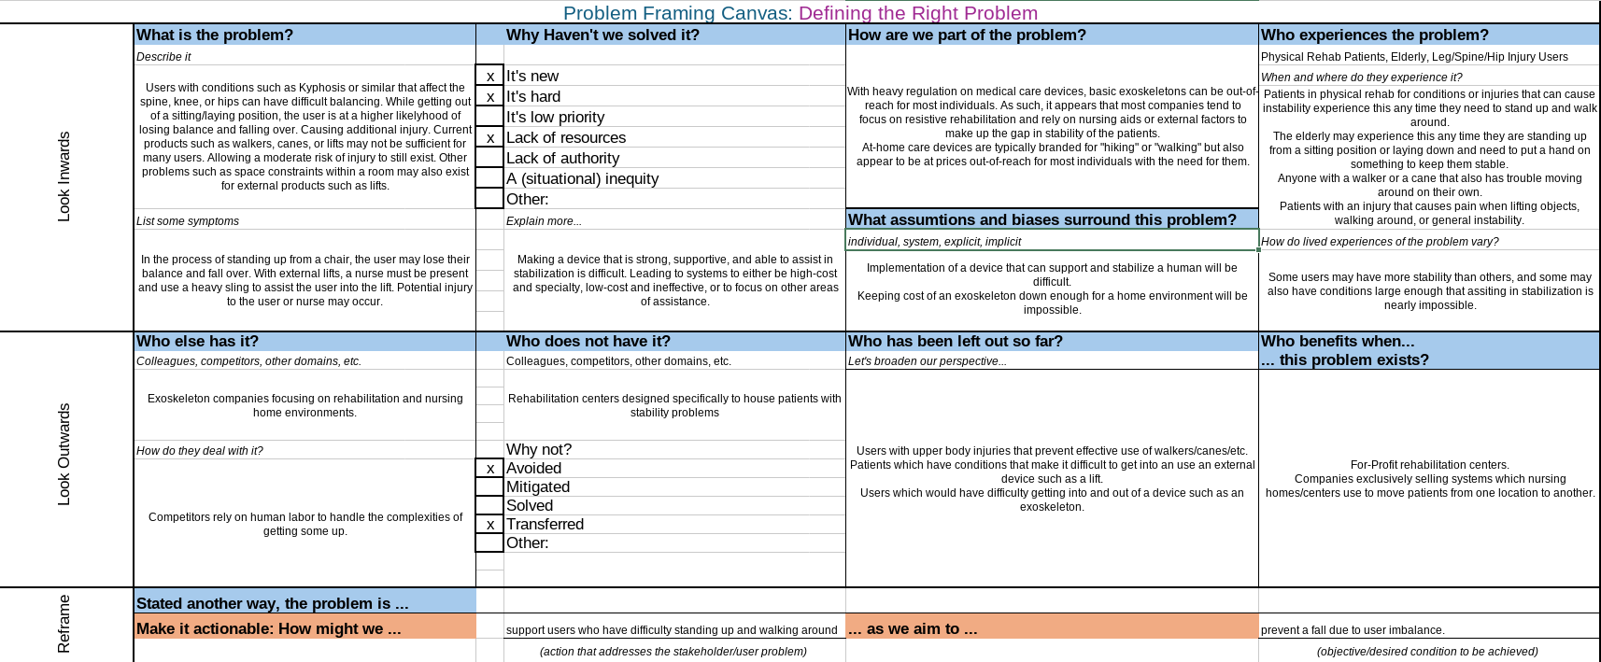
Problem Framing Canvas – Rev 1
Introductions
Concept Definition
Elicit Stakeholder Needs
Requirements Definition
Develop Architectures
Design Evolution
Summary

Slide 21
Mission Statement (SOI -> Operator Lift Assistance System) – Rev 1
To allow a user to get up from a sitting or lying position to a standing or walking position with limited or no assistance from another person (Value Needed)
By developing a system to support, assist, resist, or suggest movements (haptics) to a user to keep stable. (Action Needed)
Using current and future technologies of robotics and medical devices to develop a system architecture and technology roadmap for user assistance. (Process or System Delivering the Value)
While maintaining a weight limit of X lbs that is unsupported by the system. (Constraint; Optional for Mission Statement)
Introductions
Concept Definition
Elicit Stakeholder Needs
Requirements Definition
Develop Architectures
Design Evolution
Summary

Slide 22
Mission Statement (SOI -> Operator Lift Assistance System) – Rev 2
To allow a user to get up from a sitting or lying position to a standing or walking position with limited (non-professional) or no assistance from another person (Value Needed)
By developing a system to support, assist, resist, or suggest movements (haptics) to a user to keep stable. (Action Needed)
Using current and future technologies of robotics and medical devices to develop a system architecture and technology roadmap for user assistance. (Process or System Delivering the Value)
While maintaining a weight limit of X lbs that is unsupported by the system. (Constraint; Optional for Mission Statement)
Introductions
Concept Definition
Elicit Stakeholder Needs
Requirements Definition
Develop Architectures
Design Evolution
Summary

Slide 23
Boundary Diagram (Levels) – Rev 1
n + 4 -> Movement Environments (Nursing Home, Hospital, Home)
n + 3 -> Bodies and Objects (Human, Desk, Drawer, etc.)
n + 2 -> Major Body Groups (Head, Shoulders, Knees and Toes)
n + 1 -> Minor Body Groups (Arms, Chest, Legs/Feet, etc.)
n -> Movement Systems (balance, power, support)
Introductions
Concept Definition
Elicit Stakeholder Needs
Requirements Definition
Develop Architectures
Design Evolution
Summary

Slide 24
Boundary Diagram (Levels) – Rev 2
n + 4 ->
n + 3 -> Long-Term Care and Rehabilitation Processes
n + 2 -> Environment (Medical Facility, Outdoors, Homes)
n + 1 -> User, Tangential Personnel, Environmental Objects
n -> Human Body Sections, System-Of-Interest
n - 1 ->
Introductions
Concept Definition
Elicit Stakeholder Needs
Requirements Definition
Develop Architectures
Design Evolution
Summary

Slide 25
Boundary Diagram – Rev 1
Human Body
Eyes & Ears
Balance Sensing
Arms
Chest
Shoulders
Weight Balancing
External Lift Assist Device (walker/cane)
Abdomen
Pelvis
Weight Balancing (Move upper body)
Upper Leg
Lower Leg
Feet
Lifting Power (Quadriceps)
Lifting Power (Calf Muscles)
Knee
Stability (Upper to Lower Leg Joint)
Weight Balancing (Shift entire body)
Upper Back
n + 2
n + 1
n
Weight Balancing (leg to body)
Context
Boundary
SOI
Environment
Non-Professional Assistant
Professional Assistant
Medical Staff
External Lifts
Lower Back
n - 1

Slide 26
Boundary Diagram – Rev 2
Human Body
Eyes & Ears
Balance Sensing
Arms
Chest
Shoulders
Weight Balancing
External Lift Assist Device (walker/cane)
Abdomen
Pelvis
Weight Balancing (Move upper body)
Upper Leg
Lower Leg
Feet
Lifting Power (Quadriceps)
Lifting Power (Calf Muscles)
Knee
Stability (Upper to Lower Leg Joint)
Weight Balancing (Shift entire body)
Upper Back
n + 2
n + 1
n
Weight Balancing (leg to body)
Context
Boundary
SOI
Environment
Non-Professional Assistant
Professional Assistant
Medical Staff
External Lifts
Lower Back
n - 1
Sacrum/Ilium
Power Infrastructure
Storage System

Slide 27
Boundary Diagram – Rev 3
Human Body
Eyes & Ears
Balance Sensing
Arms
Chest
Shoulders
Weight Balancing
External Lift Assist Device (walker/cane)
Pelvis
Upper Leg
Lower Leg
Feet
Lifting Power (Quadriceps)
Lifting Power (Calf Muscles)
Knee
Stability (Upper to Lower Leg Joint)
Weight Balancing (Shift entire body)
n + 2
n + 1
n
Weight Balancing (leg to body)
Context
Boundary
SOI
Environment
Non-Professional Assistant
Professional Assistant
Medical Staff
External Lifts
Lower Torso
n - 1
Power Infrastructure
Storage System
Sacrum/Ilium
Weight Balancing (Move upper body)

Slide 28
Human Body Structure – Leg
Leg
Quadriceps (Muscle)
Vastus lateralis
Vastus medialis
Vastus intermedius
Rectus femoris
Hamstrings (Muscle)
Biceps Femoris
Semimembranosus
Semitendinosus
Calf (Muscle)
Gastrocnemius (calf muscle)
Soleus
Plantaris
Upper
Middle
Lower
Knee (Structure)
Femur (Structure)
Tibia (Structure)
Fibula (Structure)
Foot
Tarsals (Structure)
Calcaneus
Talus
Cuboid
Cuneiforms
Navicular

Slide 29
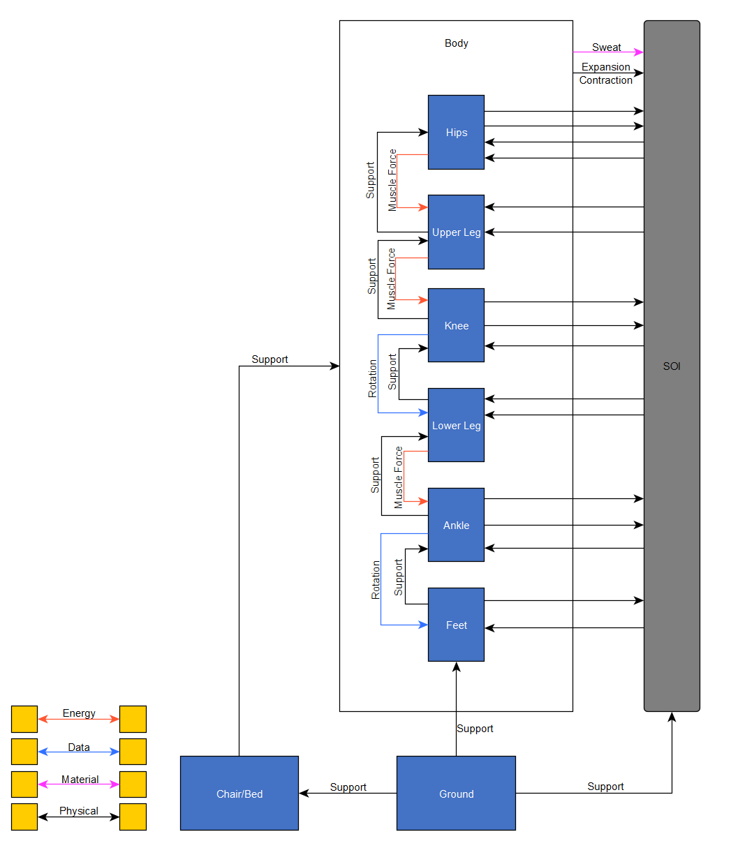
Context Diagram – Rev 1 (WIP)
Introductions
Concept Definition
Elicit Stakeholder Needs
Requirements Definition
Develop Architectures
Design Evolution
Summary
Notes:
Muscle force is transferred over the joints, rather than into them

Slide 30
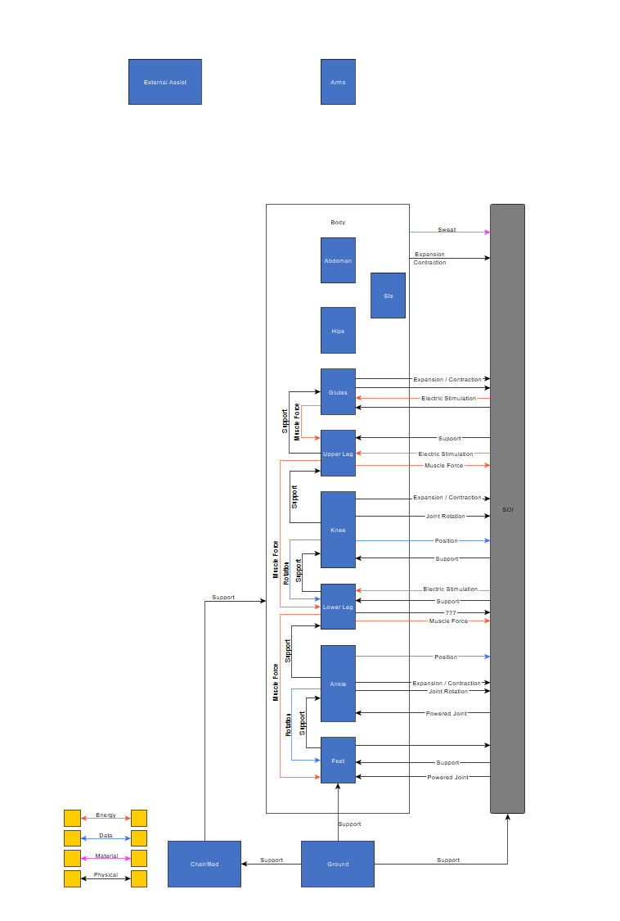
Context Diagram – Rev 2
Introductions
Concept Definition
Elicit Stakeholder Needs
Requirements Definition
Develop Architectures
Design Evolution
Summary
Notes:
Muscle force is transferred over the joints, rather than into them

Slide 31
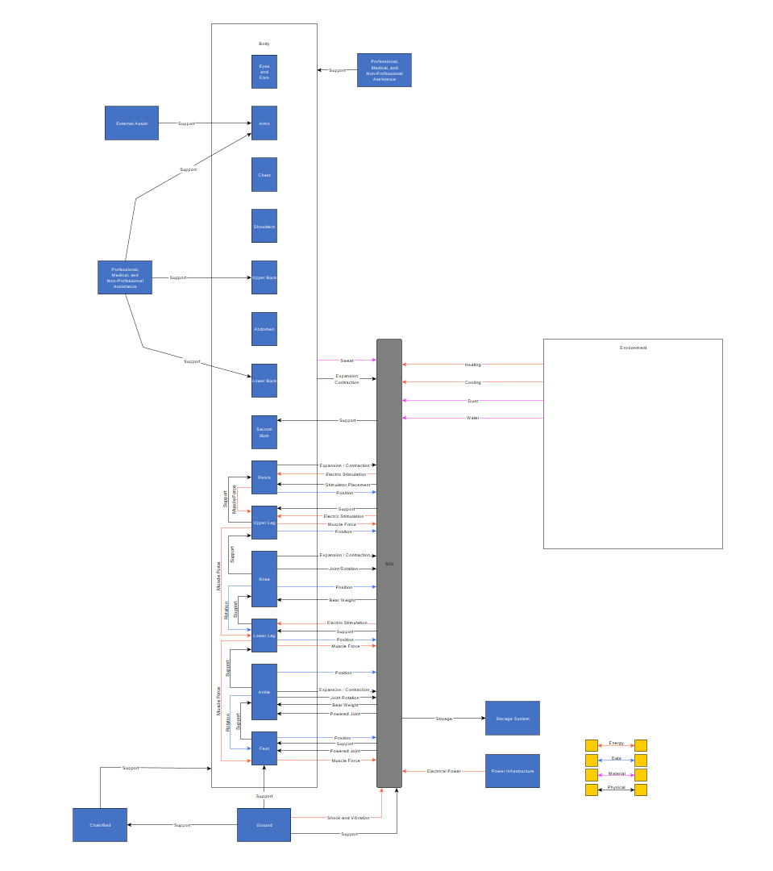
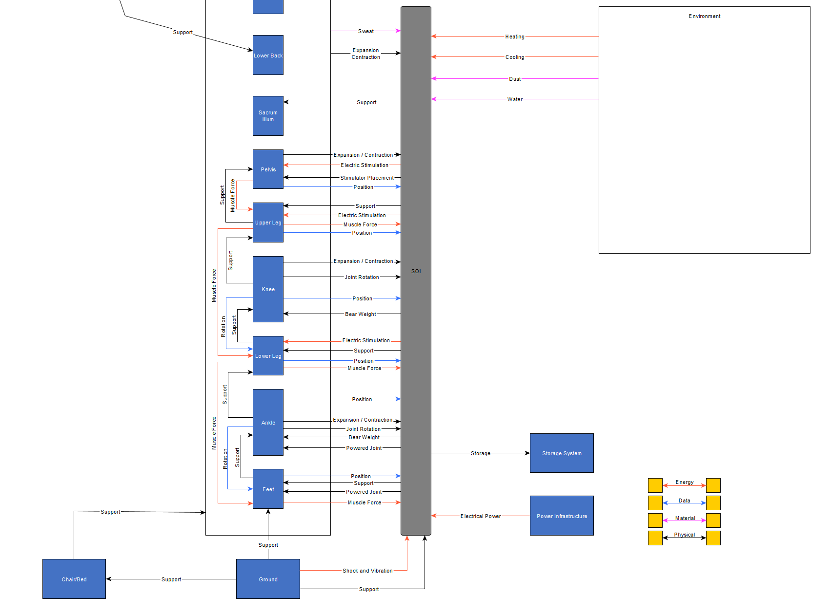
Context Diagram – Rev 3
Introductions
Concept Definition
Elicit Stakeholder Needs
Requirements Definition
Develop Architectures
Design Evolution
Summary
Notes:
Muscle force is transferred over the joints, rather than into them

Slide 32
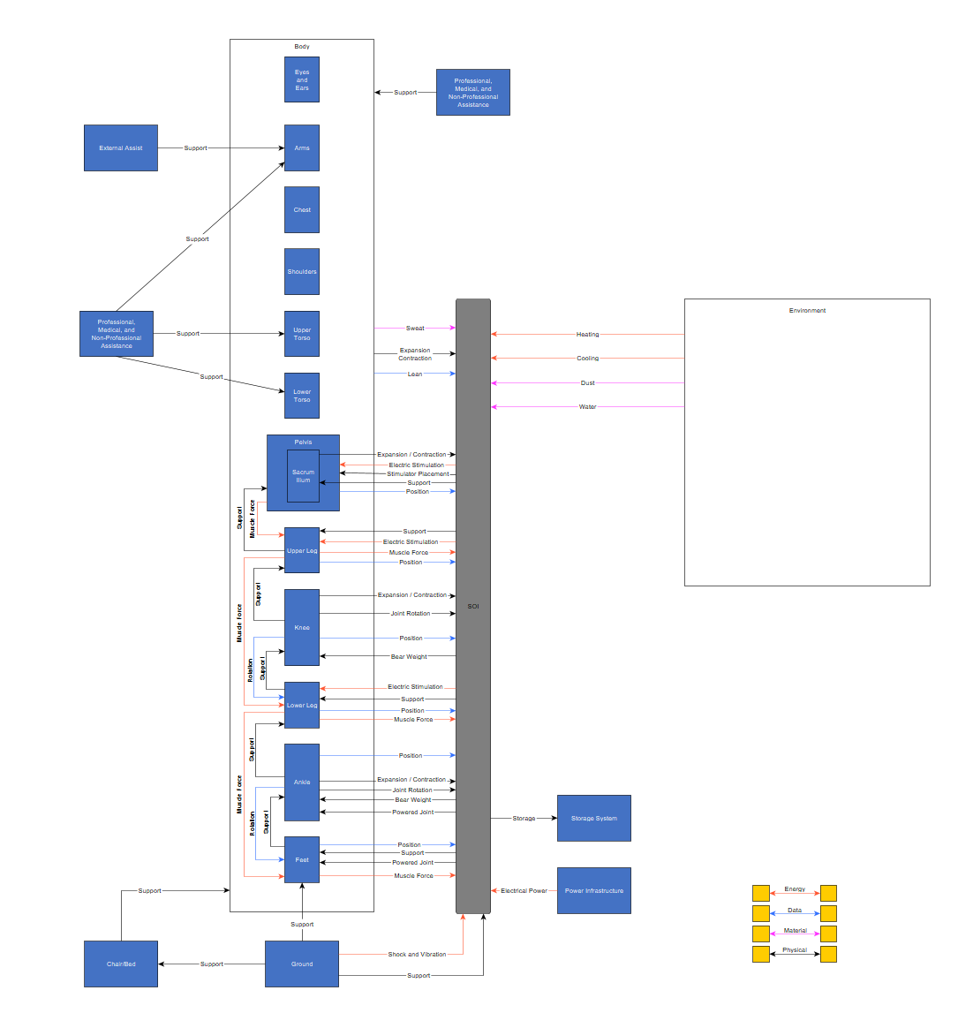
Context Diagram – Rev 4
Introductions
Concept Definition
Elicit Stakeholder Needs
Requirements Definition
Develop Architectures
Design Evolution
Summary
Notes:
Muscle force is transferred over the joints, rather than into them

Slide 33
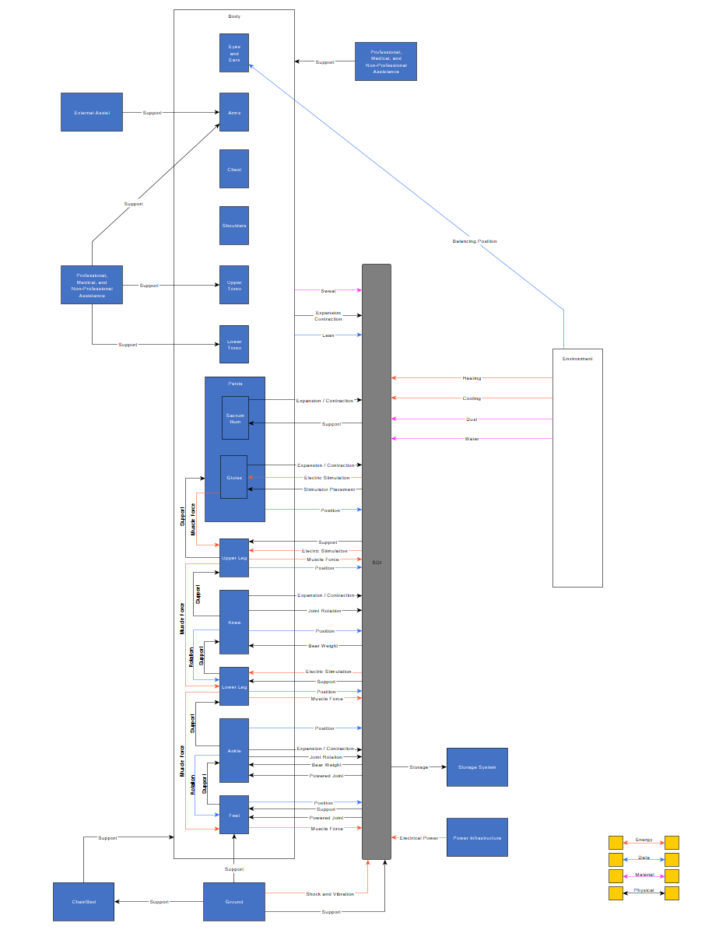
Context Diagram – Rev 5
Introductions
Concept Definition
Elicit Stakeholder Needs
Requirements Definition
Develop Architectures
Design Evolution
Summary
Notes:
Muscle force is transferred over the joints, rather than into them

Slide 34
Elicit Stakeholder Needs
ConOps & OpsCon
Identify Stakeholder Needs
Stakeholder Interviews
Stakeholder Needs & Requirements
Use Cases
Sequence Diagrams

Slide 35
Elicit Stakeholder Needs
ConOps & OpsCon
List of Stakeholders

Slide 36
Concept of Operations (ConOps) – Rev 1
Sit-To-Stand Transition
Upright State
Sitting Position
Stand-To-Sit Transition
Walking
Leaning
Moving Objects
Contingency:
Fail to Equip System;
System Failure, needs removal
Contingency:
Trips and Falls
Emergency Contingency:
Health Issues, Immediate Device Removal Required;
Complete Device Failure;
External Hazard Present
Introductions
Concept Definition
Elicit Stakeholder Needs
Requirements Definition
Develop Architectures
Design Evolution
Summary
Notes:
Is the “injury to recovery” cycle important for the concept-of-operations level?

Slide 37
OpsCon– Sitting Position (Get In/Out Of Device) – Rev 1
Get Ready
Get Set
Go
Get Unready
Get Unset
Prepare Unit
Position Unit
Put On Unit
Secure Unit
Power On Unit

Slide 38
OpsCon– Sit-To-Stand Transition – Rev 1
Get Ready
Get Set
Go
Get Unready
Get Unset
Position Body
Brace
Lift
Let Go
Stabilize

Slide 39
OpsCon – Upright State – Rev 1
Get Ready
Get Set
Go
Get Unready
Get Unset
Text
Text
Text
Text
Text

Slide 40
OpsCon – Stand-To-Sit Transition – Rev 1
Get Ready
Get Set
Go
Get Unready
Get Unset
Position Body
Brace
Lower
Let Go
Rest

Slide 41
Concept of Operations (ConOps) - Facility – Rev 2
“resting state”
Prepare for Movement
Relocate User
“finalize movement”
Contingency:
Fail to Equip System;
System Failure, needs removal
Contingency:
Trips and Falls
SOI
Emergency Contingency:
Health Issues, Immediate Device Removal Required;
Complete Device Failure;
External Hazard Present
Introductions
Concept Definition
Elicit Stakeholder Needs
Requirements Definition
Develop Architectures
Design Evolution
Summary
Notes:
Is the “injury to recovery” cycle important for the concept-of-operations level?

Slide 42
OpsCon– Relocate User – Rev 1 (Day in the life)
Get Ready
Get Set
Go
Get Unready
Get Unset
Get Unit From Storage
Pick up off ground
Pull unit towards user
Unplug unit from charger or plug unit into power source
Put On Unit
Open unit if necessary
Put user into unit or grab unit
Power On Unit
Power on unit
Verify unit power availability
Sit-To-Stand
Support body using arms
Simplify - Forward rotation of the trunk until hip leaves seat
Simplify - Whole body rotates forward and rises with the ankle joint at the center and lower legs stops flexing forward
Simplify - Backwards flexion of the lower leg hip joint motion is dominate and trunk moves up
Simplify - Lower leg and thigh flex forward
Monitor
Monitor power availability
Monitor stability
Upright Movement
Adjust major hip muscles for balance
Use lower body for lifting power
Adjust Balance
Balance body using body mass
Lean forward/backward and side-to-side for balance
Stand-To-Sit
Support body using arms
Rotate body to chair
Lower body to seat
Shift over on seat as needed (bench)
Rest system and body on chair or bench
Put Unit In Storage
Store within reach
Take Off Unit
Remove unit from body
Close unit for storage
Power Off Unit
Switch Unit Power Off
Unplug unit from power source or plug unit into charger
Contingency
Unit stops functioning
Failure of sensing system
Unit does not have enough power to run
Unexpected Motion of User
Emergency Contingency
Trips or Falls
External health issue; Immediate removal necessary
External hazard present; user needs to move from area quickly

Slide 43
Use Cases – Rev 1
Introductions
Concept Definition
Elicit Stakeholder Needs
Requirements Definition
Develop Architectures
Design Evolution
Summary

Slide 44
Use Case Summary – Rev 1
Introductions
Concept Definition
Elicit Stakeholder Needs
Requirements Definition
Develop Architectures
Design Evolution
Summary

Slide 45
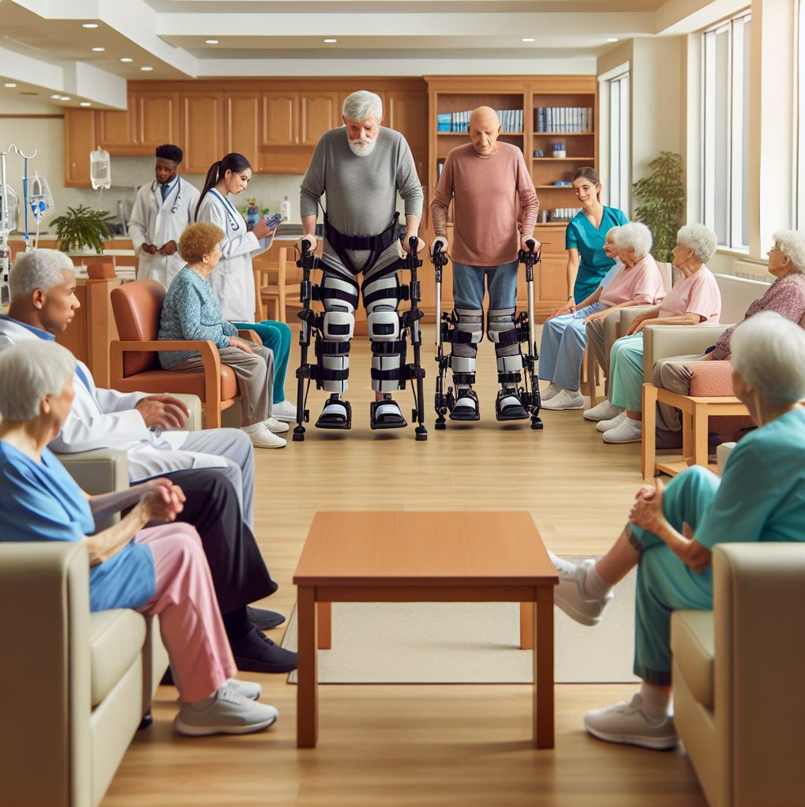
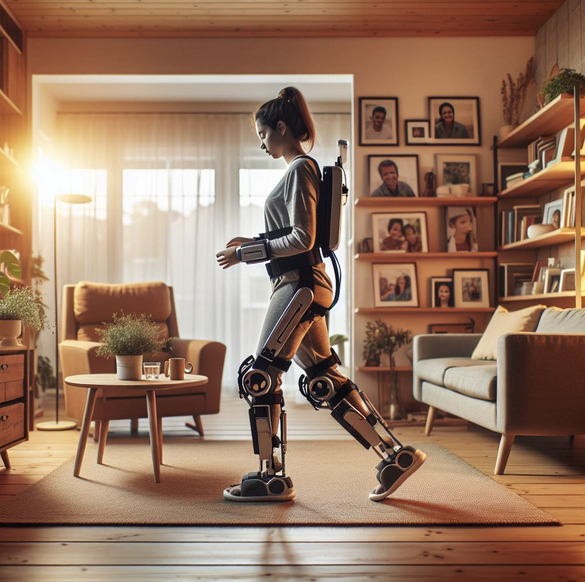

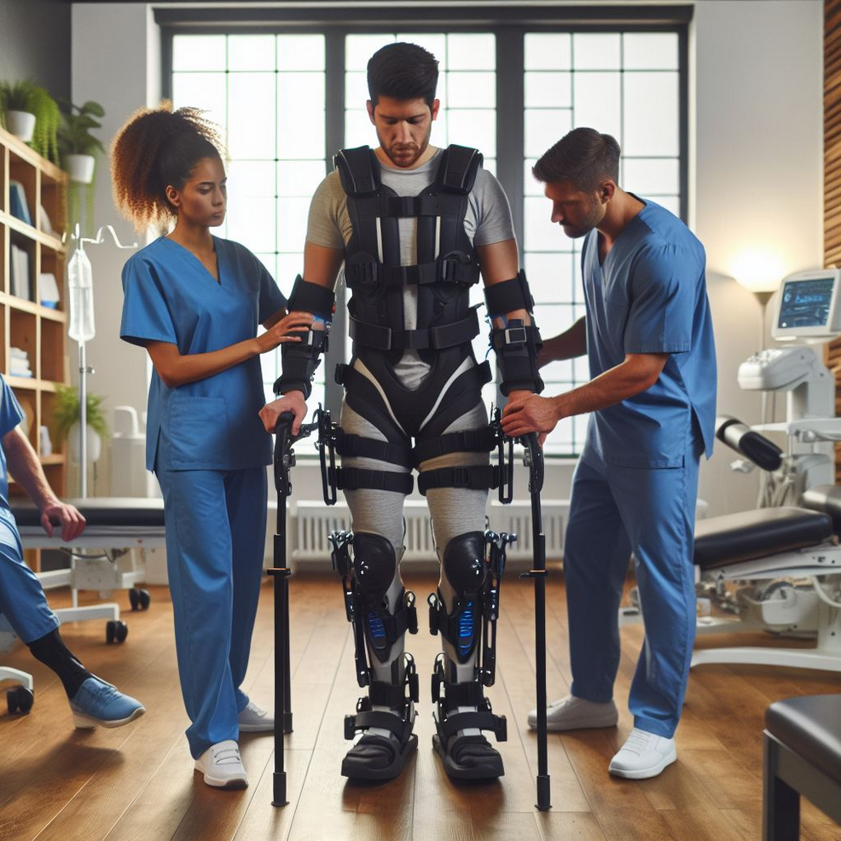
Target Markets – Rev 1
Images Generated by DALL-E 3
Long-Term Nursing
Home Care
Medical Facilities
Rehabilitation Center
Introductions
Concept Definition
Elicit Stakeholder Needs
Requirements Definition
Develop Architectures
Design Evolution
Summary

Slide 46
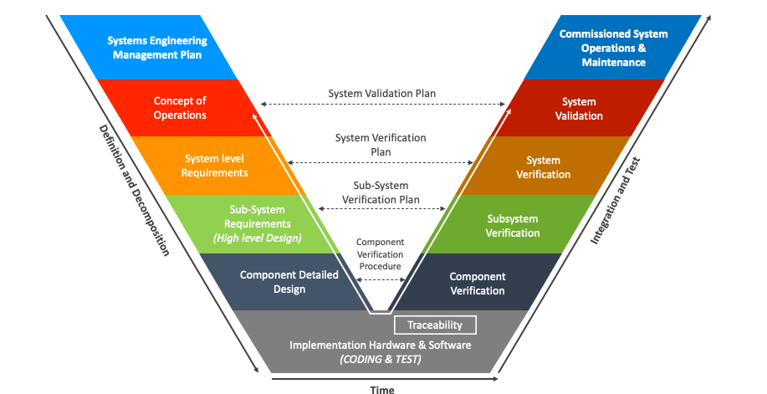
Stakeholders – Rev 1
User
Medical (Hospitals)
Rehab Centers
UND (Class)
Voice-Of-Customer
FDA
FCC
Design Team
Test Team
Project Suppliers
Legend
Component Builders
External Stakeholder
Internal Stakeholder
Introductions
Concept Definition
Elicit Stakeholder Needs
Requirements Definition
Develop Architectures
Design Evolution
Summary

Slide 47
How to Elicit Stakeholder Needs – Rev 1
Customer
Interviews
VOC Feedback
Regulatory (FDA)
Find regulatory requirements
Review Public Submissions for tangential products
Compliance (EMC, Biocompatibility)
Find documentation and selection of standards
Medical Rehabilitation Facilities
Voice of customer/Interviews
Safety
Hazard and Risk Assessment
Project Suppliers
Evaluate standard supply lines for medical components
Estimate needs of suppliers (lead times, costs, detail, etc.)
Mechanical parts, circuit boards, custom software
FCC
Find documentation of emissions and regulatory requirements
Introductions
Concept Definition
Elicit Stakeholder Needs
Requirements Definition
Develop Architectures
Design Evolution
Summary

Slide 48
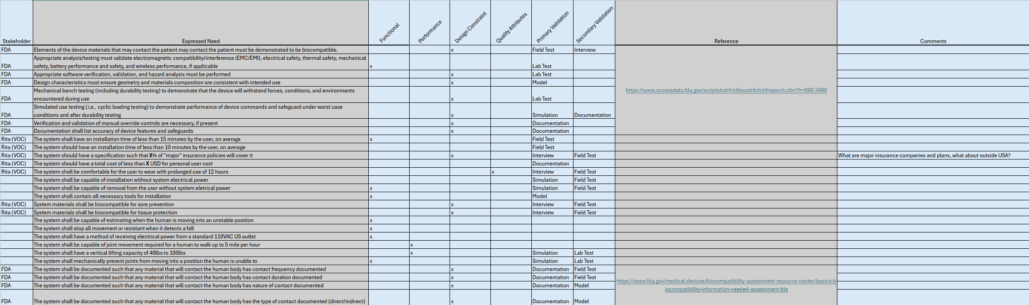
Stakeholder Requirements (Not Comprehensive) – Rev 1
Introductions
Concept Definition
Elicit Stakeholder Needs
Requirements Definition
Develop Architectures
Design Evolution
Summary

Slide 49
Stakeholder Needs (priority adjusted) - Rev 1
Introductions
Concept Definition
Elicit Stakeholder Needs
Requirements Definition
Develop Architectures
Design Evolution
Summary

Slide 50
Stakeholder Value Network – Rev 1
Introductions
Concept Definition
Elicit Stakeholder Needs
Requirements Definition
Develop Architectures
Design Evolution
Summary

Slide 51
Requirements Definition
System Requirements
Requirement Validation
Functional Architecture
Functional DSM

Slide 52
Types of System Requirements
Functional
What must the system do? What action must be performed by the system?
Performance
How well must it be done? Mesurable in terms of quantitative, qualitative, coverage, and timelines.
Typically expands on Functional Requirements.
Design Constraints
What design characteristics must be followed or achieved?
Note: Typically set by higher authority for business reasons.
Quality Attributes
How will the users determine the quality of the system, given the other requirements?
Usability, Maintainability, etc.
Specification must include agreement on how it will be measured.
Introductions
Concept Definition
Elicit Stakeholder Needs
Requirements Definition
Develop Architectures
Design Evolution
Summary

Slide 53
System Requirements Summary – Rev 1
FDA
Comply with regulations on lower-limb exoskeletons
Biocompatibility
User
Comfortability
Usability
Medical Facilities
Cost to insurance
Cost to Facility
Ability to use without external systems
Time to put on and take off
Cost of unit
Total Cost of Care
Professional assistance requirements
Safety
Biocompatibility
Protect user from overrotation
Protect user during a trip or fall
Documentation
User and physician guides and manuals
Complexity of use
Introductions
Concept Definition
Elicit Stakeholder Needs
Requirements Definition
Develop Architectures
Design Evolution
Summary

Slide 54
Requirements Validation Strategy – Rev 1
Design
Biocompatibility / Comfortability
Nature of Contact Evaluation
In-Field Frequency of Contact Evaluation
Interviews on looks of product
Mockup for comfortability and fitment
Hardware
Software
Electrical
Stress-Test Simulations
Interference detection
Design For Manufacturing
Software Simulation
Bench-Test Hardware Simulation
In-Field testing
Harness fitup
3D Routing
Drop/Fall Testing
3D Printing prototypes
Biocompatible material selection documentation
Introductions
Concept Definition
Elicit Stakeholder Needs
Requirements Definition
Develop Architectures
Design Evolution
Summary

Slide 55
System Requirements Validation – Rev 1
Introductions
Concept Definition
Elicit Stakeholder Needs
Requirements Definition
Develop Architectures
Design Evolution
Summary

Slide 56
System Requirements Validation Summary – Rev 1
Introductions
Concept Definition
Elicit Stakeholder Needs
Requirements Definition
Develop Architectures
Design Evolution
Summary

Slide 57
Develop Architecture
Structural Architecture
Structural DSM
Interface Definition
Form-to-Function Mapping

Slide 58
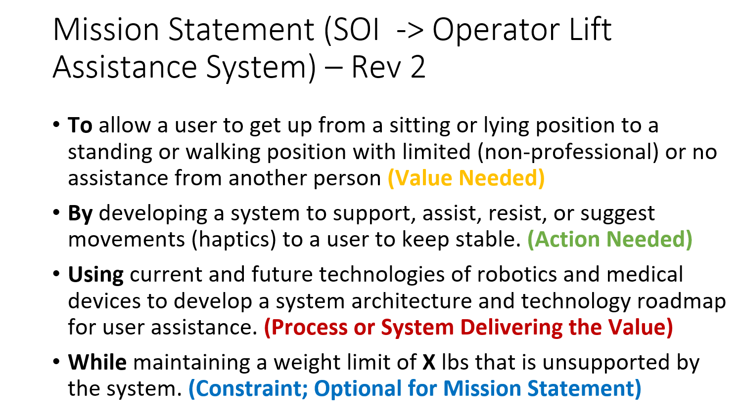
Functional Architecture – Rev 1
Sense Stability
Rehabilitate/Assist Movement
n+1
n
n - 1
n+2
,n+2 function
Support Bodyweight
Power Joints (assist)
Resist Movement (rehabilitate)
Retrain Muscle
Support Feet
Support Legs
Support Hips
Support Knees
Sense Position
Counteract Instability
Protect User
Power Ankle
Power Knee
Power Hips Break This One Down
Transmit Power
Transmit Data
Transmit Power
Operator Comfort
Process Data
Introductions
Concept Definition
Elicit Stakeholder Needs
Requirements Definition
Develop Architectures
Design Evolution
Summary

Slide 59
Functional Architecture – Rev 2
Sense Stability
Rehabilitate/Assist Movement
n+1
n
n - 1
Support Body/Unit Weight
Power Joints (assist)
Retrain Muscle
Support Feet
Support Legs
Support Hips
Support Knees
Sense Position
Counteract Instability
Protect User
Power Ankle
Power Knee
Power Hips Break This One Down
Transmit Data
Transmit Power
Operator Comfort
Process Data
Lift Assist
Professional Assist
Non-Professional Assist
Medical Staff
External Lift
Resist Power
Introductions
Concept Definition
Elicit Stakeholder Needs
Requirements Definition
Develop Architectures
Design Evolution
Summary

Slide 60
Functional Architecture – Focus Functions – Rev 2
Focus Function – Fall 2024
Basic Functionality to meet position, power, and support.
Sense Stability
Rehabilitate/Assist Movement
n+1
n
n - 1
Support Body/Unit Weight
Power Joints (assist)
Retrain Muscle
Support Feet
Support Legs
Support Hips
Support Knees
Sense Position
Counteract Instability
Protect User
Power Ankle
Power Knee
Power Hips Break This One Down
Transmit Data
Transmit Power
Operator Comfort
Process Data
Lift Assist
Professional Assist
Non-Professional Assist
Medical Staff
External Lift
Resist Power
Introductions
Concept Definition
Elicit Stakeholder Needs
Requirements Definition
Develop Architectures
Design Evolution
Summary

Slide 61
Functional Architecture – Rev 3
Sense Stability
Rehabilitate/Assist Movement
n+1
n
n - 1
Support Body/Unit Weight
Power Joints (assist)
Retrain Muscle
Support Feet
Support Legs
Support Hips
Support Knees
Sense Position
Counteract Instability
Protect User
Power Ankle
Power Knee
Power Hips Break This One Down
Transmit Data
Transmit Power
Operator Comfort
Process Data
Lift Assist
Professional Assist
Non-Professional Assist
Medical Staff
External Lift
Resist Power
Store Energy
Charge System
Introductions
Concept Definition
Elicit Stakeholder Needs
Requirements Definition
Develop Architectures
Design Evolution
Summary

Slide 62
Functional Architecture – Rev 3
Sense Stability
Rehabilitate/Assist Movement
n+1
n
n - 1
Support Body/Unit Weight
Power Joints (assist)
Retrain Muscle
Support Feet
Support Legs
Support Hips
Support Knees
Sense Position
Counteract Instability
Protect User
Power Ankle
Power Knee
Power Hips Break This One Down
Transmit Data
Transmit Power
Operator Comfort
Process Data
Lift Assist
Professional Assist
Non-Professional Assist
Medical Staff
External Lift
Resist Power
Store Energy
Charge System
Introductions
Concept Definition
Elicit Stakeholder Needs
Requirements Definition
Develop Architectures
Design Evolution
Summary

Slide 63
Functional Architecture – Focus Functions – Rev 2
Focus Function – Fall 2024
Basic Functionality to meet position, power, and support.
Sense Stability
Rehabilitate/Assist Movement
n+1
n
n - 1
Support Body/Unit Weight
Power Joints (assist)
Retrain Muscle
Support Feet
Support Legs
Support Hips
Support Knees
Sense Position
Counteract Instability
Protect User
Power Ankle
Power Knee
Power Hips Break This One Down
Transmit Data
Transmit Power
Operator Comfort
Process Data
Lift Assist
Professional Assist
Non-Professional Assist
Medical Staff
External Lift
Resist Power
Store Energy
Charge System
Introductions
Concept Definition
Elicit Stakeholder Needs
Requirements Definition
Develop Architectures
Design Evolution
Summary

Slide 64
Functional Architecture – Rev 1
MVP
(Fall 2024)
Sense Stability
Rehabilitate/Assist Movement
n+1
n
n - 1
n+2
,n+2 function
Support Bodyweight
Power Joints (assist)
Resist Movement (rehabilitate)
Retrain Muscle
Support Feet
Support Legs
Support Hips
Support Knees
Sense Position
Counteract Instability
Protect User
Power Ankle
Power Knee
Power Hips Break This One Down
Transmit Power
Transmit Data
Transmit Power
Operator Comfort
Process Data
Introductions
Concept Definition
Elicit Stakeholder Needs
Requirements Definition
Develop Architectures
Design Evolution
Summary

Slide 65
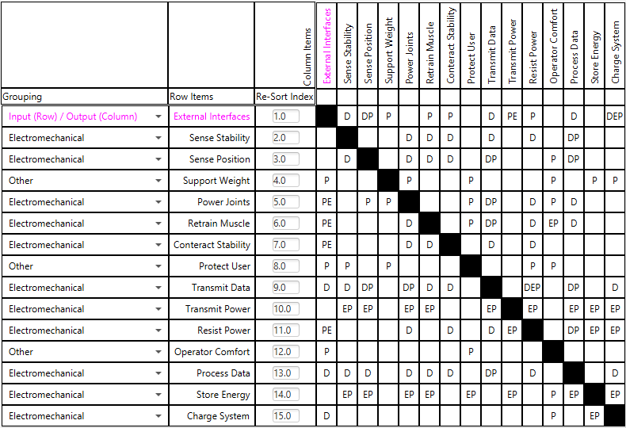
Functional DSM – Rev 1
Legend:
D – Data Interface
P – Physical Interface
E – Energy Interface
M – Material Interface
Introductions
Concept Definition
Elicit Stakeholder Needs
Requirements Definition
Develop Architectures
Design Evolution
Summary

Slide 66
Structural Architecture – Rev 1
Introductions
Concept Definition
Elicit Stakeholder Needs
Requirements Definition
Develop Architectures
Design Evolution
Summary

Slide 67
Structural DSM – Rev 1
Introductions
Concept Definition
Elicit Stakeholder Needs
Requirements Definition
Develop Architectures
Design Evolution
Summary

Slide 68
Multi-Domain Matrix – Rev 1
Introductions
Concept Definition
Elicit Stakeholder Needs
Requirements Definition
Develop Architectures
Design Evolution
Summary

Slide 69
Design Evolution
Trade Space Analysis
Technology Assessment
Technology Roadmap
MOE & MOP
Risk Assessment

Slide 70
Design Evolution
Morphological Matrix
Trade Space
Trade Space Analysis

Slide 71
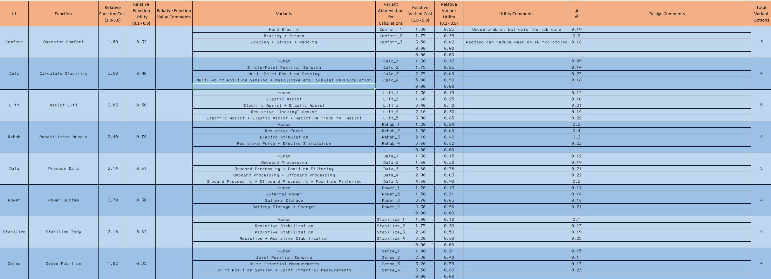
Morphological Matrix w/ Weights – Rev 1
DO NOT SHARE/REPRODUCE
Introductions
Concept Definition
Elicit Stakeholder Needs
Requirements Definition
Develop Architectures
Design Evolution
Summary

Slide 72
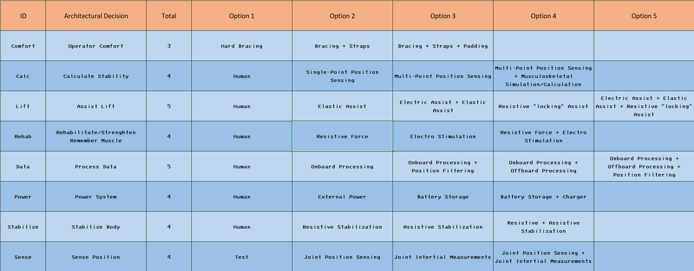
Morphological Matrix – Rev 1
Introductions
Concept Definition
Elicit Stakeholder Needs
Requirements Definition
Develop Architectures
Design Evolution
Summary

Slide 73
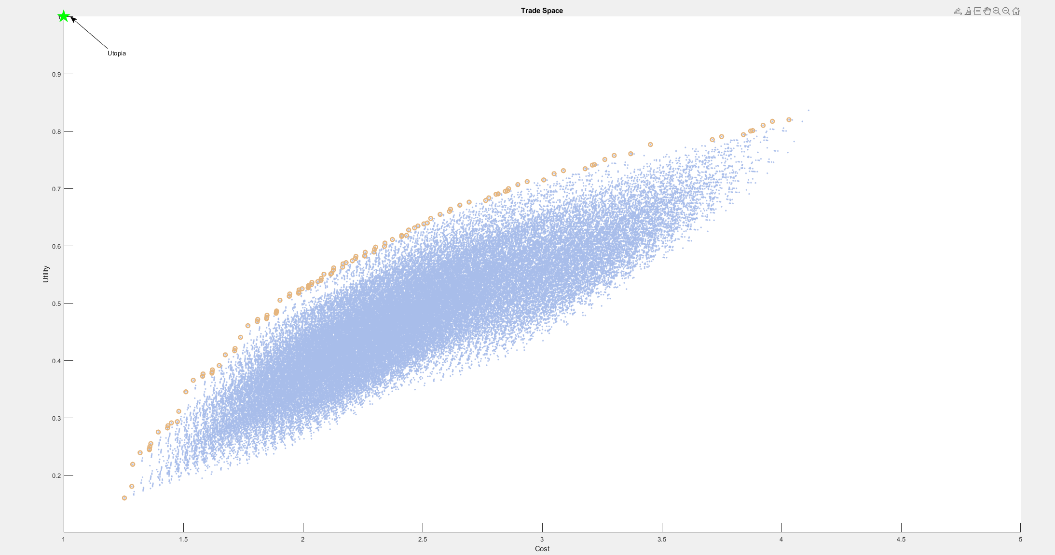
Trade Space (without long-term care costs)– Rev 1
Introductions
Concept Definition
Elicit Stakeholder Needs
Requirements Definition
Develop Architectures
Design Evolution
Summary

Slide 74
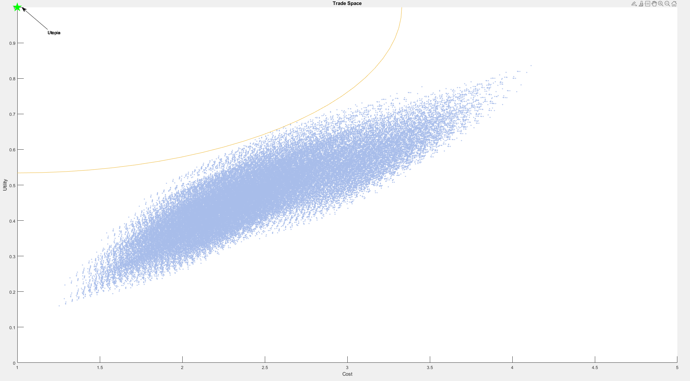
Trade Space Analysis – Rev 1
Preferred Concept
Future State #2
Future State #1
Closest to Utopia
Inflection Point #3
Inflection Point #2
Inflection Point #1
Manual Rehab
Introductions
Concept Definition
Elicit Stakeholder Needs
Requirements Definition
Develop Architectures
Design Evolution
Summary

Slide 75
Trade Space Stars – Rev 1
Preferred Concept
Future State #2
Future State #1
Closest to Utopia
Inflection Point #3
Inflection Point #2
Inflection Point #1
Manual Rehab
Introductions
Concept Definition
Elicit Stakeholder Needs
Requirements Definition
Develop Architectures
Design Evolution
Summary

Slide 76
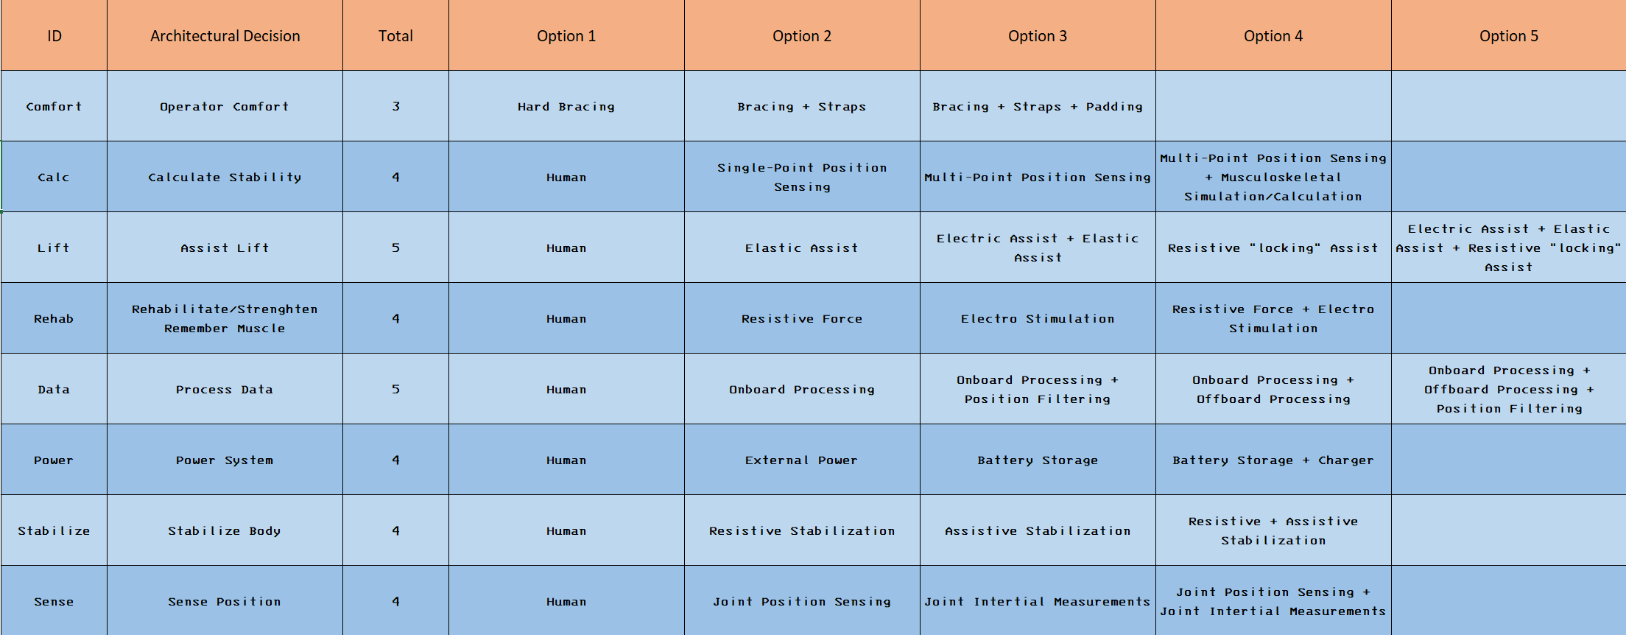
Trade Space Analysis (cont.) – Rev 1 *up to closest-to-utopia
Introductions
Concept Definition
Elicit Stakeholder Needs
Requirements Definition
Develop Architectures
Design Evolution
Summary

Slide 77
Technology Roadmap – Rev 1
Introductions
Concept Definition
Elicit Stakeholder Needs
Requirements Definition
Develop Architectures
Design Evolution
Summary

Slide 78
MOS, MOE & MOP – Rev 1
Measure of Success | Measure of Effectiveness | Measure of Performance
Assisted Stabilization | Sit-To-Stand Balancer + Standing/Walking Balancer + Stand-To-Sit Balancer | % of users needing external support + % of users needing external devices (walker/cane, etc.)
Extra Weight Supported By User | User Weight + User Supported Weight | User Weight + Unit Weight – Weight Supported By Unit
Resistive Rehabilitation
Muscle Retraining
Variability of Use |  | % of daily activities assisted by unit
Introductions
Concept Definition
Elicit Stakeholder Needs
Requirements Definition
Develop Architectures
Design Evolution
Summary

Slide 79
Risk Assessment – Rev 1
Introductions
Concept Definition
Elicit Stakeholder Needs
Requirements Definition
Develop Architectures
Design Evolution
Summary

Slide 80
Summary
Project Summary
Project Recommendations

Slide 81
Project Summary
Introductions
Concept Definition
Elicit Stakeholder Needs
Requirements Definition
Develop Architectures
Design Evolution
Summary

Slide 82
Project Recommendations
Introductions
Concept Definition
Elicit Stakeholder Needs
Requirements Definition
Develop Architectures
Design Evolution
Summary

Slide 83
Conclusion

